Slide 1
Describing Syntax
CMSC 330: Programming Languages

Slide 2
Syntax
Syntax is the set of rules that defines the structure of valid expressions, statements, and program units in a programming language.
For example:
x = 5; is valid in C++/Java
[1;2;3] |> List.map square |> List.fold_left (+) 0 is valid in OCaml

Slide 3
Defining Syntax
A grammar is a finite metalanguage used to define the syntax of a language
Our interest: using grammars to define the syntax of a programming language
  Context-free grammars (CFGs)
  Backus-Naur form (BNF)
  Extended Backus-Naur form

Slide 4
Defining Syntax: Terminology
A sentence is a string of characters over some alphabet
A language is a set of sentences
A lexeme is the lowest level syntactic unit of a language (e.g., class, if, int, =)
A token is a category of lexemes (e.g., identifier, keyword, operator)

Slide 5


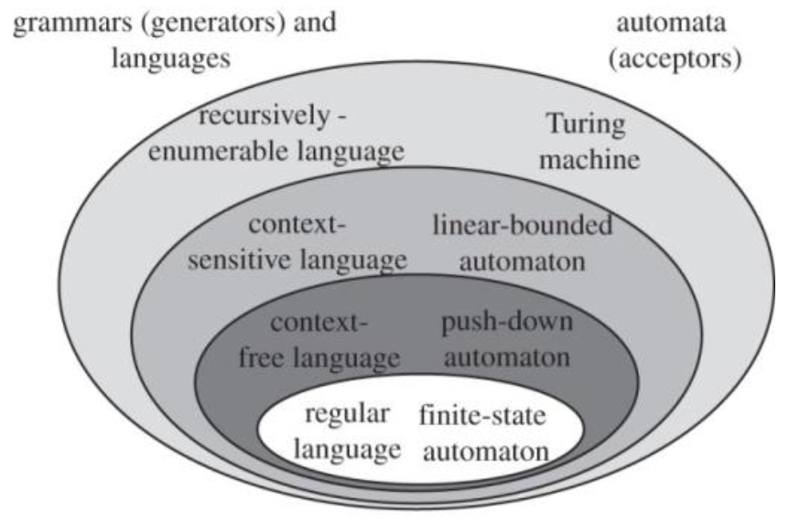

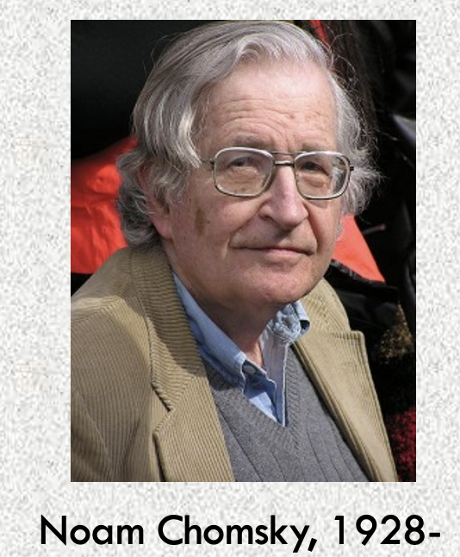
Chomsky Hierarchy
Meant to describe syntax of natural languages
Context-free grammars and BNF are equivalent
More in CMSC 340: Computational Models

Slide 6
Context-free Grammars (CFGs)
A CFG is a 4-tupe
G = (V, Σ, P, S), where
  V is a finite set of non-terminals
  Σ is a finite set of terminals
  P is a finite set of production rules, each of the form A –> α, where A is in V and α is in (V ∪ Σ)*
  S in V is the start symbol

Slide 7
CFGs: Example
Let G = ({Expr, Term}, {1, 2, +, *}, P, Expr}, where
P is the set of productions rules:
  Expr -> Expr + Term | Term
  Term -> Term * Term | 1 | 2
Can you derive 1 + 2 * 2 + 2?

Slide 8
Backus-Naur Form (BNF)
Created by John Backus (1959) to describe the syntax of Algol 58
Peter Naur helped refine and popularize the notation in the Algol 60 Report
BNF Rule: LHS ::= RHS (or simply LHS -> RHS)
Terminals: often correspond to tokens like INTEGER_LITERAL, KEYWORD
Non-terminals: symbols that can be expanded using production rules to define language constructs like Expr, Stmt

Slide 9
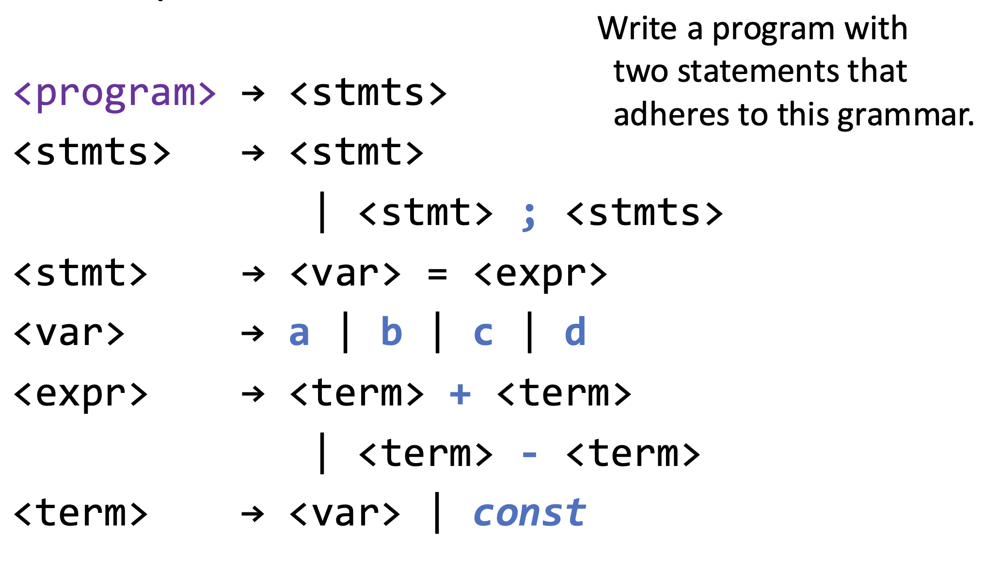
BNF Grammar: Example

Slide 10
BNF Grammar: Exercise
Design a BNF grammar that can generate all unsigned integers
Derive 928

Slide 11
Extended BNF (EBNF)
EBNF, BNF, and CFGs have the same expressive power
Optional parts are placed in brackets […]
  <proc_call> ::= ident [(<expr_list>)]
Grouping list of RHSs are placed inside parentheses and separated via vertical bars (must pick one)
  <term> ::= <term> (+ | -) const
Repetitions (0 or more) are placed inside braces { }
  <ident> ::= letter { letter|digit }

Slide 12
EBNF: Example
BNF
    <expr> → <expr> + <term>
    | <expr> - <term>
    | <term>
    <term> → <term> * <factor>
    | <term> / <factor>
    | <factor>
What does the EBNF look like?
    <expr> → <term> { (+ | -) <term> }
    <term> → <factor> { (* | /) <factor> }

Slide 13
EBNF: Exercise
Write EBNF rules for Java if statement
  Terminals: if, (, ), else,
  Non-terminals: <if_stmt>, <stmt>, <expr>
What does Java Language Spec say?

Slide 14
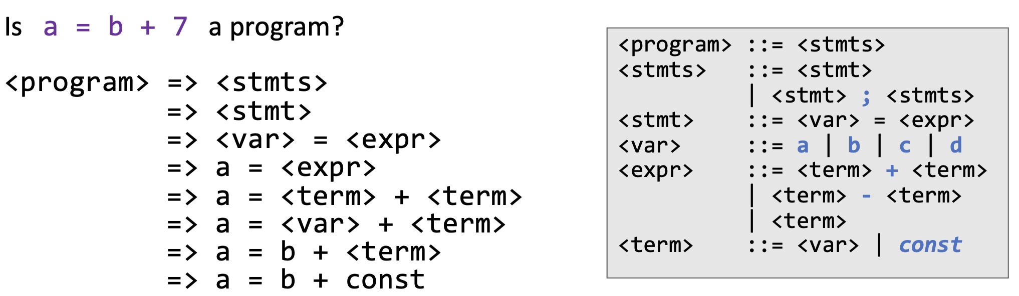
Verifying Syntax
A derivation is a repeated application of rules, starting with the start symbol and ending with all terminals
This is called a leftmost derivation since at each step, we expanded the leftmost non-terminal
Perform a leftmost derivation of a = b + 1

Slide 15
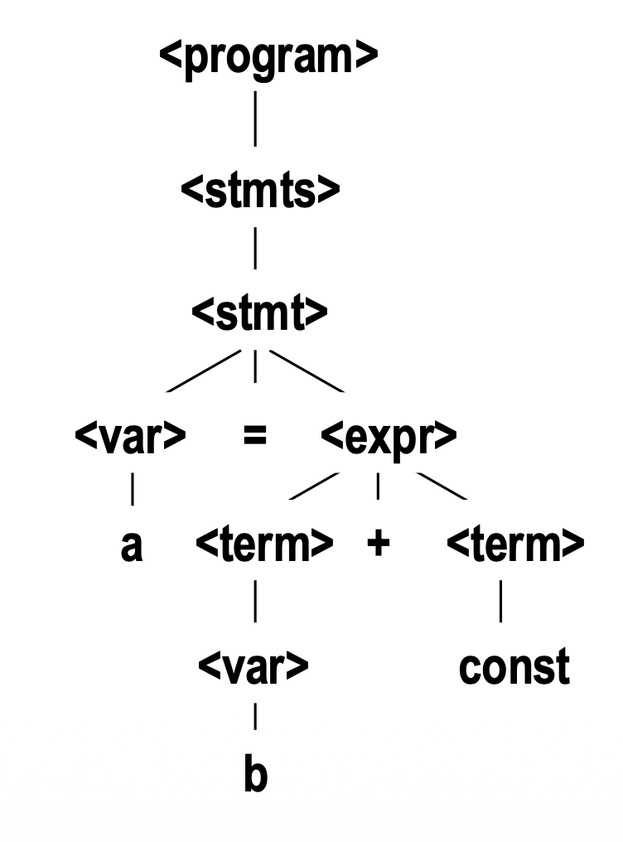
Parse Tree
A hierarchical (tree) representation of a derivation

Slide 16
Ambiguity
A grammar is ambiguous if and only if it generates a sentence that has two or more distinct parse trees
E.g., <expr> -> <expr> + <expr> | const
Show this is ambiguous
Hint: Try derive const + const + const

Slide 17
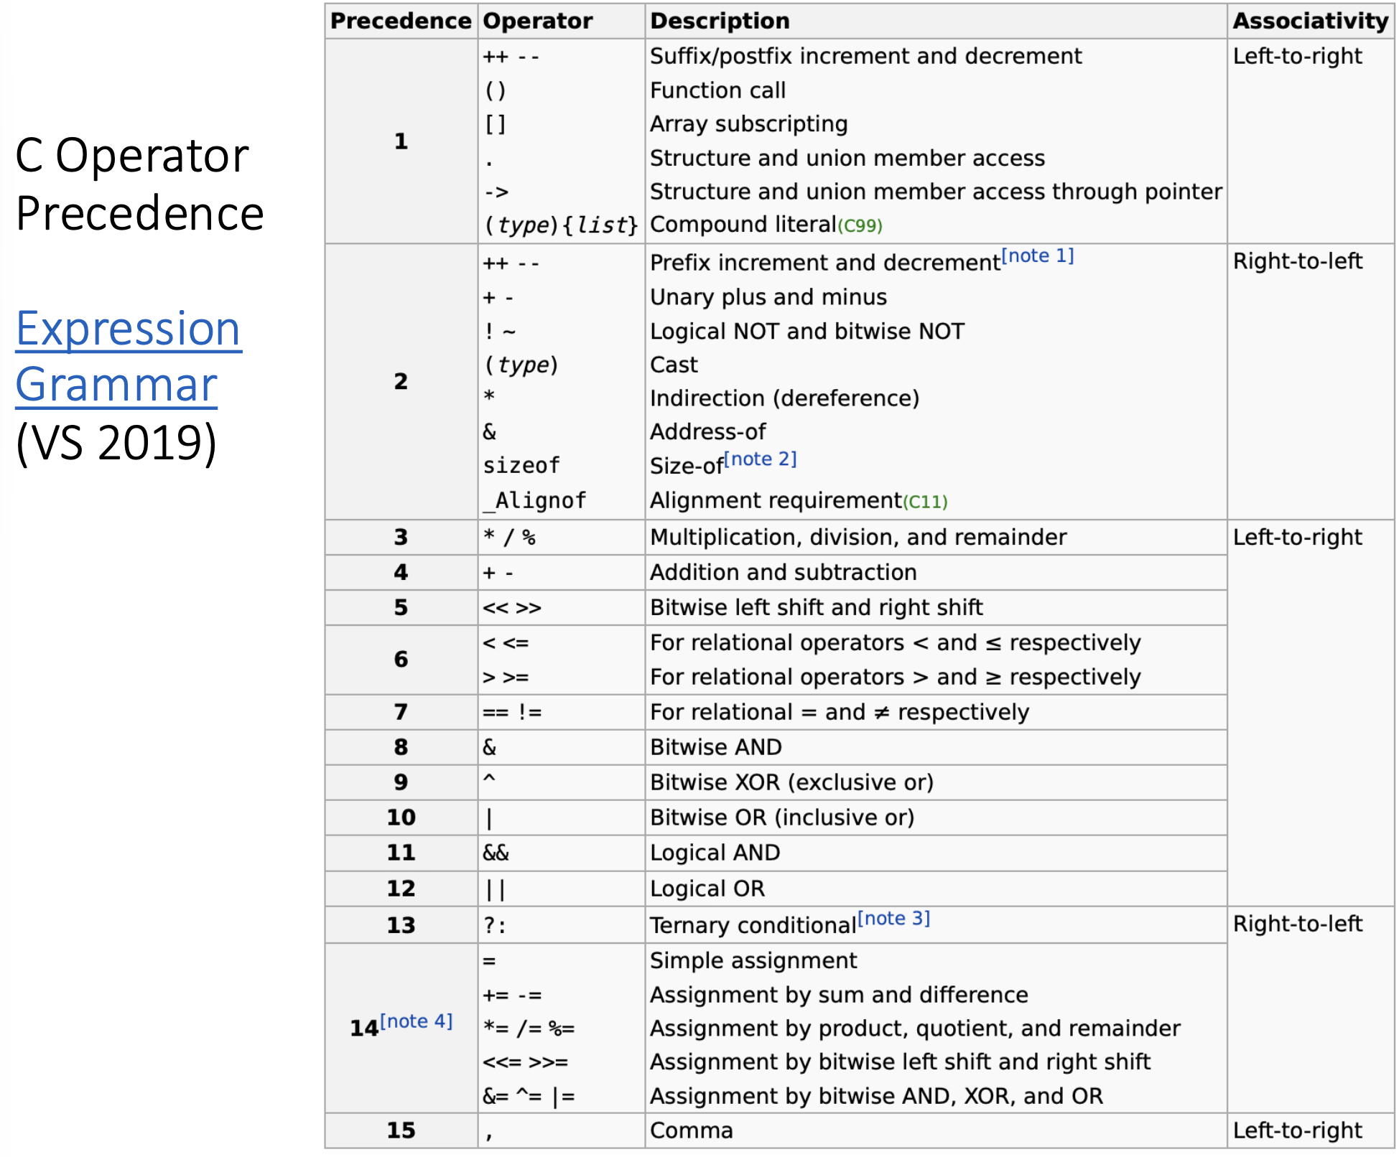
Associativity and Precedence

Slide 18
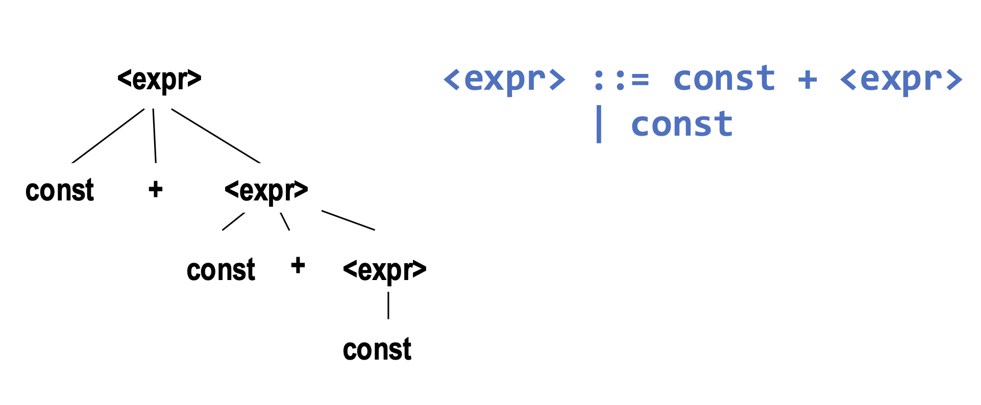
Associativity and Precedence
Parse tree should indicate precedence levels and associativity of operators
  Left recursion → left-associative
  Right recursion → right-associative
  New non-terminal → higher precedence

Slide 19
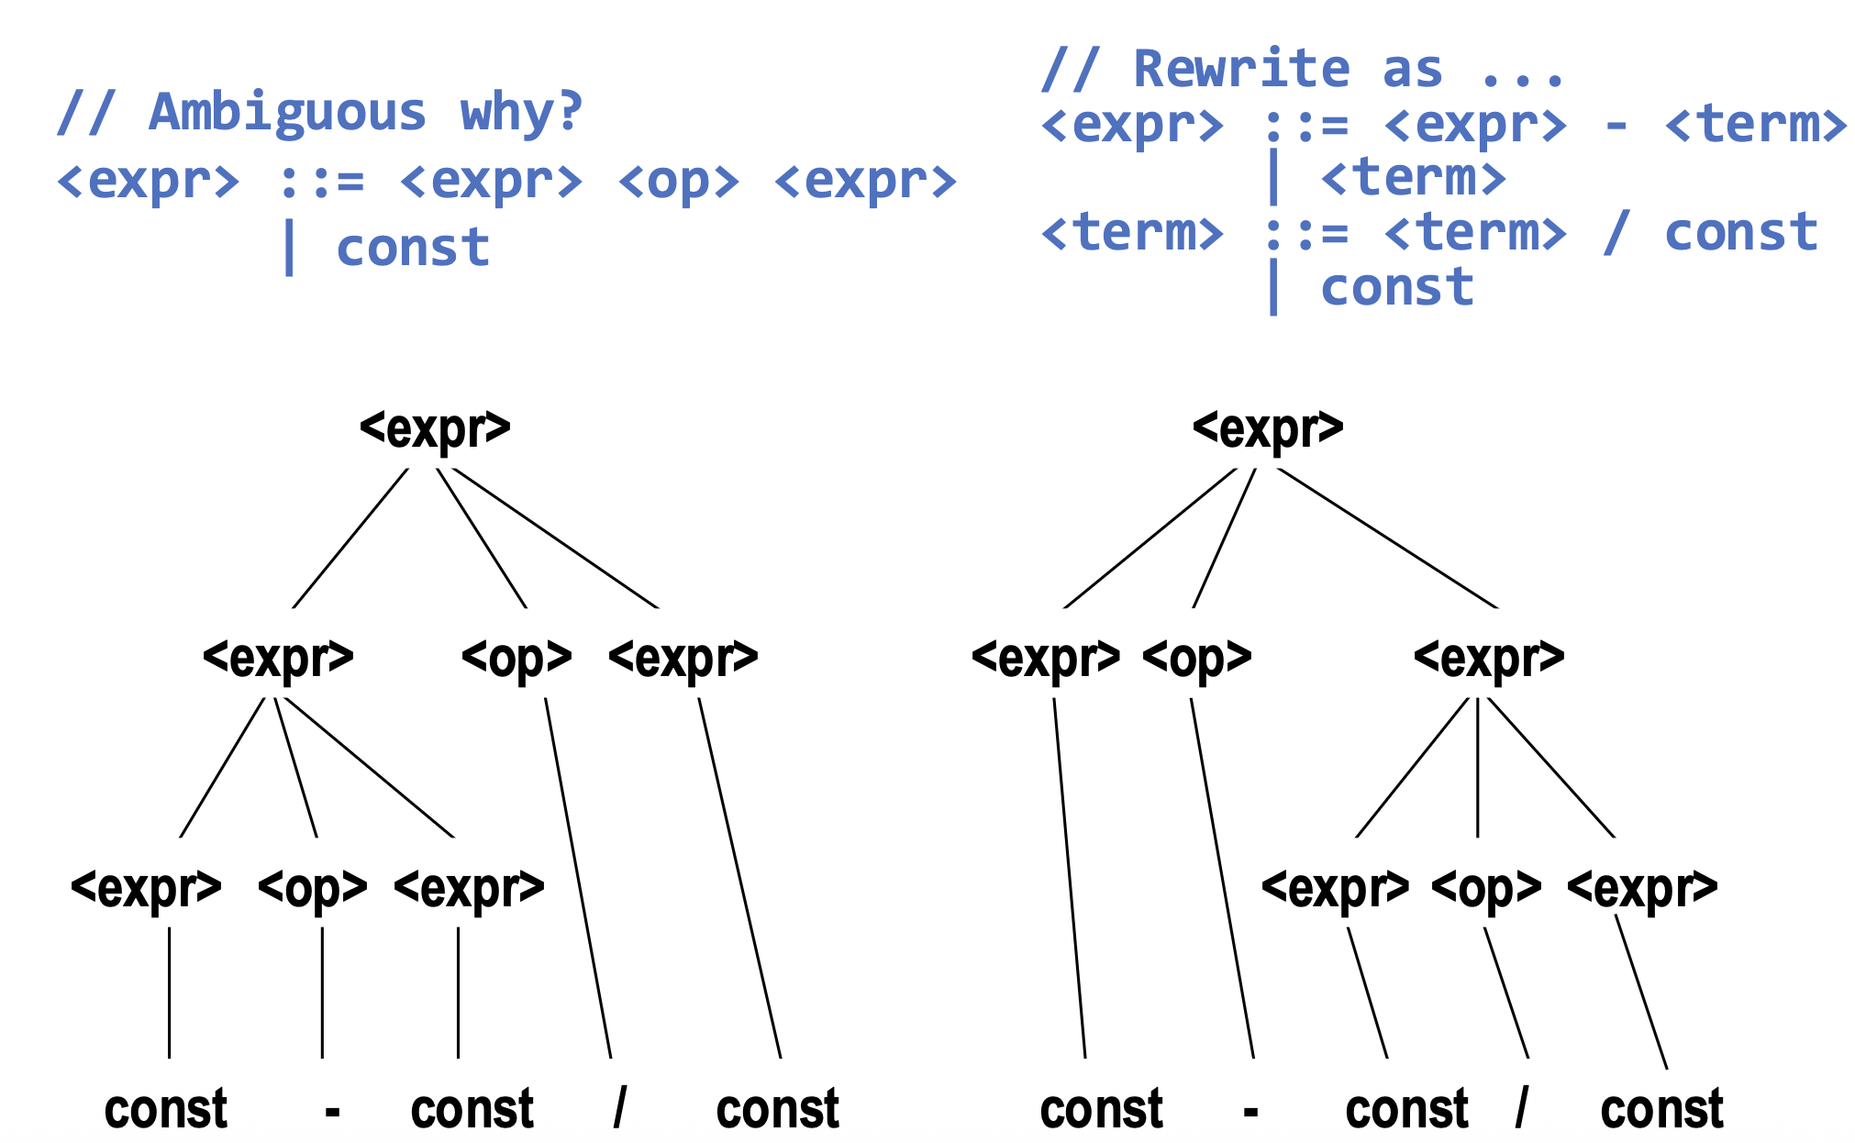
Supporting Precedence

Slide 20
Exercise
Write unambiguous rules for expressions with +, /, and (). Precedence is (), /, then +
Notes:
<expr> ::= <expr> + <term> | <term>
<term> ::= <term> / <factor> | <factor>
<factor> ::= ( <expr> ) | INTEGER_LITERAL

Slide 21
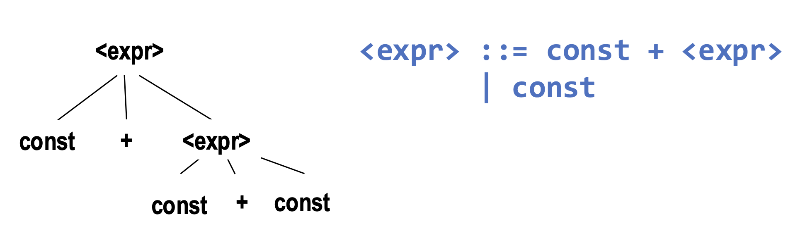
Supporting Associativity
What is the associativity of + in this grammar?
Where is the recursion?

Slide 22
Exercise
Add a rule to our <expr> grammar for exponentiation (**), with precedence one higher than division (/).
This operator should be right associative.
Notes:
<expr> ::= <expr> + <term> | <term>
<term> ::= <term> / <power> | <power>
<power> ::= <factor> ** <power> | <factor> // right-associative
<factor> ::= ( <expr> ) | INTEGER_LITERAL

Slide 23
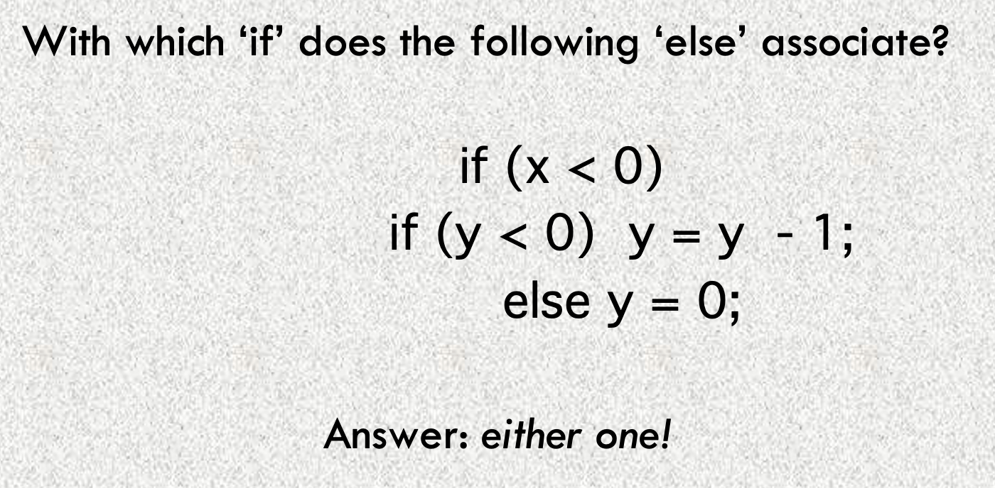
The Dangling Else
<if_stmt> -> if ( <expr> ) <stmt> |
if ( <expr> ) <stmt> else <stmt>

Slide 24
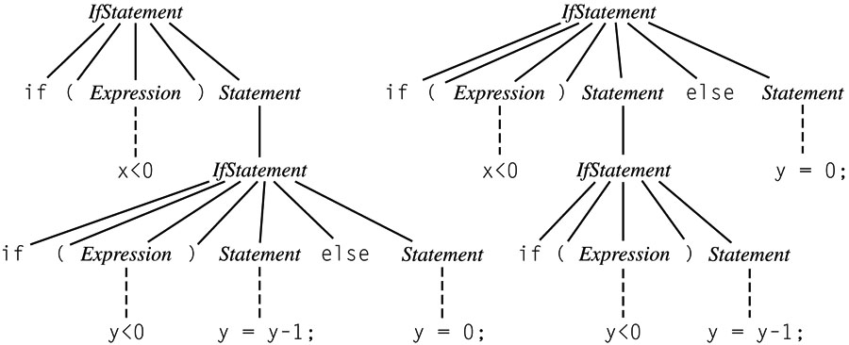
The Dangling Else Ambiguity

Slide 25
Solving Dangling Else Ambiguity
Algol 60, C, C++: associate each else with closest if; use {} or begin…end to override.
Algol 68, Modula, Ada: use explicit delimiter to end every conditional (e.g., if…fi)
Java: rewrite the grammar to limit what can appear in a conditional:
  <IfThenStmt> -> if ( <Expr> ) <Stmt>
  <IfThenElseStmt> -> if ( <Expr> ) <StmtNoShortIf>
  else <Stmt>

